Slide 1
CAPSTONE PROJECT - MID DEFENCE
DATED : 25th Oct 2023

Slide 2
INTRODUCTION
I am Engr Muhammad Raza studying at “High Impact Deep Learning” at “Technical Enclave” Gilgit and currently working as RF Optimization Engineer at SCO GB
My team members are:
1. Engr Aitizaz Haider 2. Engr Abdul Wahid
Project title: “Cellular Network Drive Test Log Analysis and Classification”
The purpose of this project is to automate the report generation during PTA QoS Survey report which minimize time duration in manual processing of drive test logs
During drive testing of cellular network, multiple logs of format “23Feb09 121917.1” and “23Feb09 121917.2” are being collected
The above logs have been processed by python coding and a CSV file is formulated for further processing
The Logs are categorized as “Mobile Terminating”, “Mobile Originating”, “3G Data” and “4G Data” according to “Logs Name” and “Size of log in KB” features

Slide 3
DATASET DESCRIPTION
The dataset used in the project is drive test logs, collected during drive testing at different clusters in GB area (Gilgit, Hunza, Sost, Gahkuch, Astore, Chilas, Skardu, Khaplu and Shigar).
The source of data is Nemo Outdoor software collected logs during drive testing at different clusters in GB.
The total number of logs collected are five hundred (500) and size of dataset is 800 MB.
The CSV file containing useful features such as “log name”, “date”, “time”, “size of log”, “label” and “Slice” (a part of log name) has been formulated from collected drive test logs

Slide 4
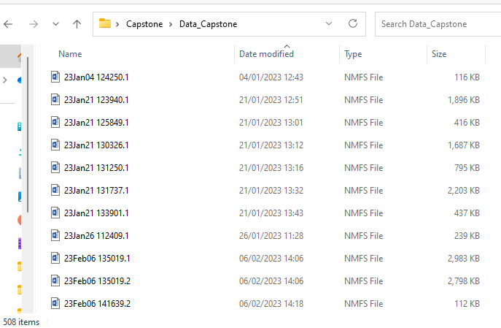
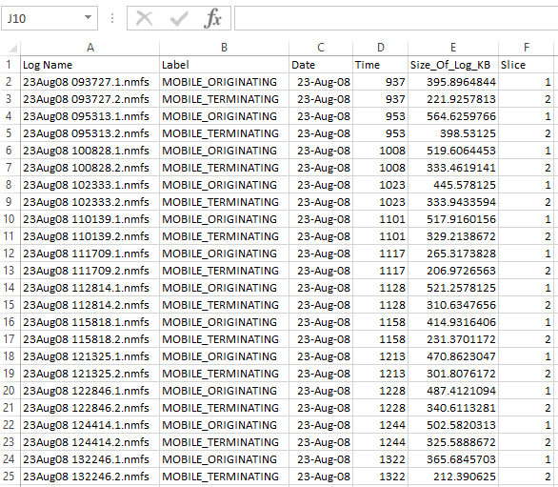
DATASET PRE-PROCCESING

Slide 5
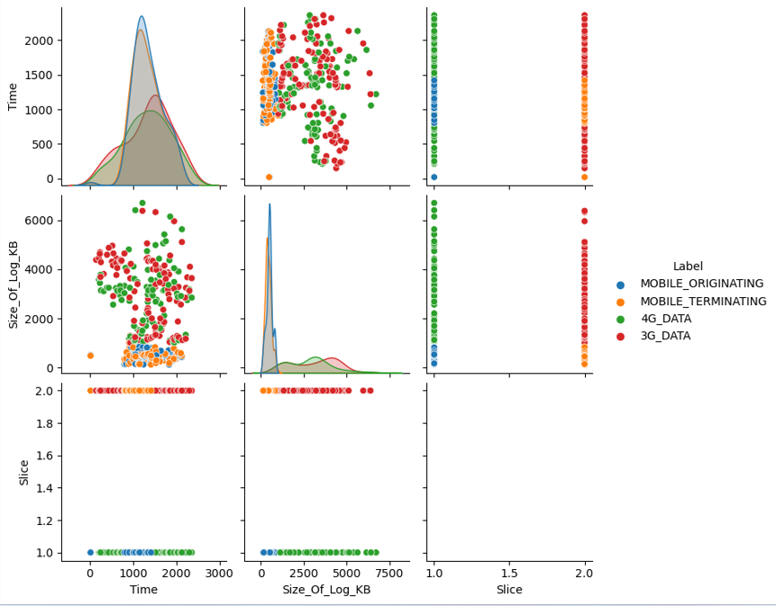
DATA VISUALIZATION- SCATTER & LINE GRAPHS

Slide 6
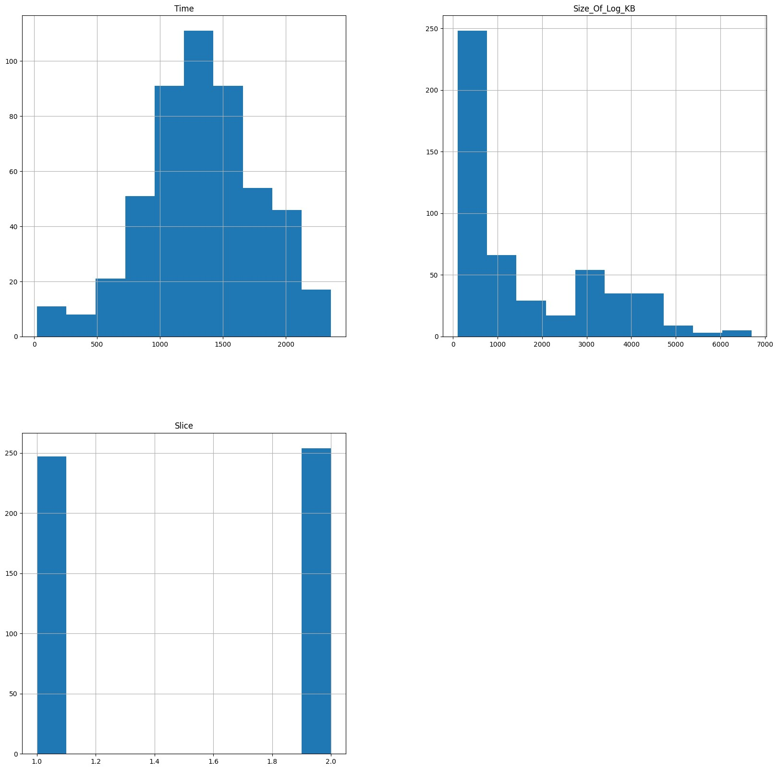
DATA VISUALIZATION – BAR GRAPHS

Slide 7
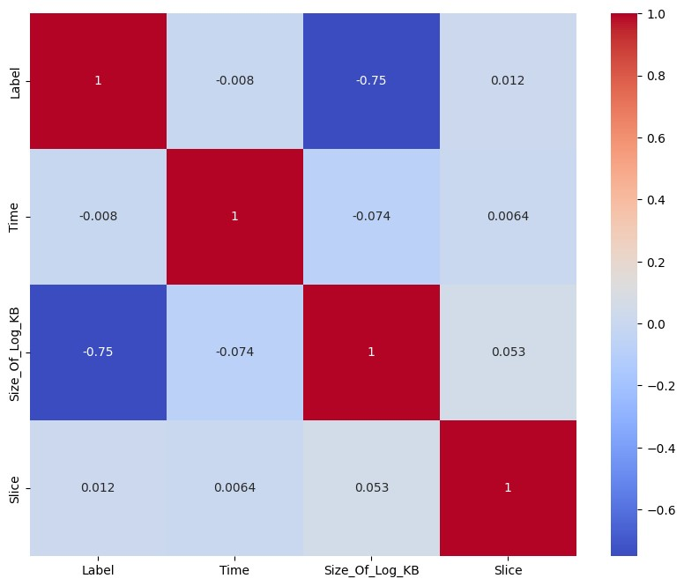
DATA VISUALIZATION – HEAT MAP

Slide 8
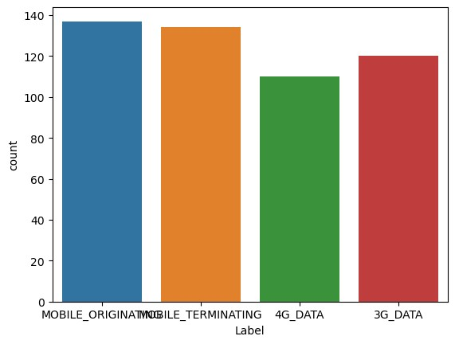
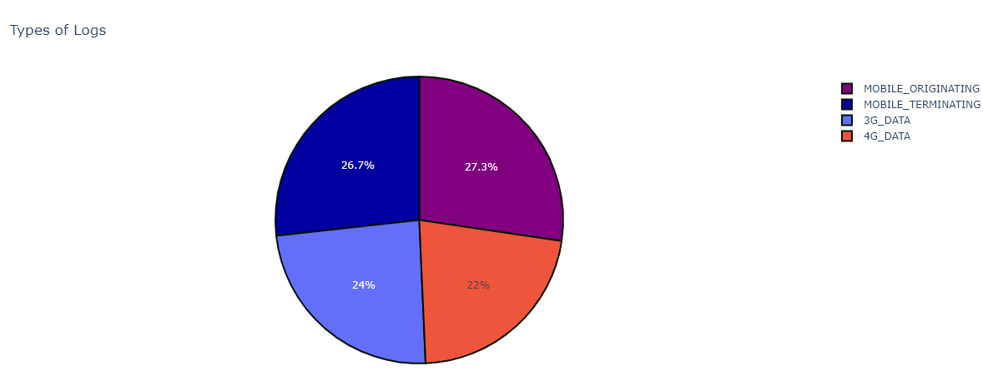
BEFORE DATA OVERSAMPLING
The number of samples in all four classes are not same, therefore the performance of model affected and low accuracy has been observed

Slide 9
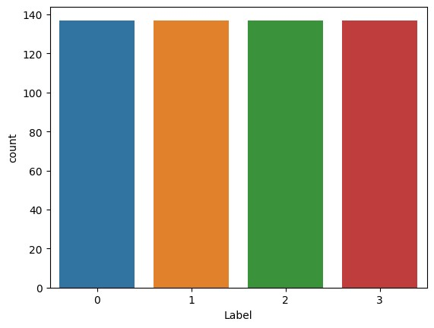
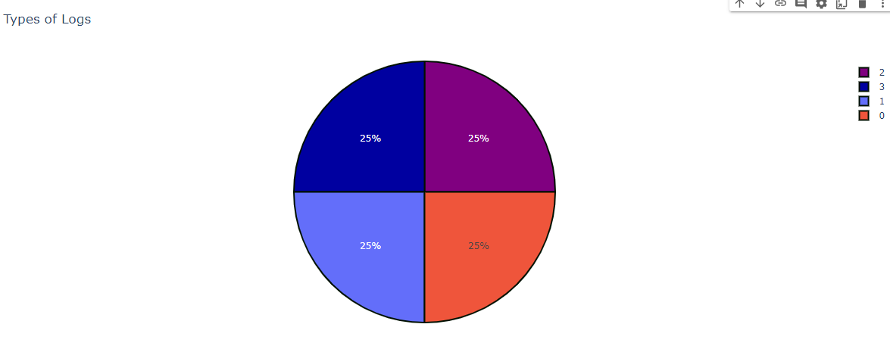
AFTER DATA OVERSAMPLING
The number of samples in all four classes are balanced by oversampling and therefore the performance of model has been enhanced and high performance has been achieved

Slide 10
DATASET IMPORTANT FEATURES
Total 500 logs are collected drive test logs data and a CSV file is generated, containing following features:
“log name”, “label”, “date”, “time”, “size of logs in KB” and “Slice”
From generated CSV file data, two features “Size of Logs” and “Slice” (a part of log name) are important and will be considered as input and log category i.e. “Label” will be considered as output for selected supervised machine learning model.

Slide 11
PROBLEM STATEMENT
Cellular network logs collected during drive testing can’t be identify and categorized easily as there are a lots of logs (500 logs).
The collected drive testing logs may be categorized and labelled manually which will consumed a lot of time (even days) for formulation of final report.
By this project, the drive test logs will be categorized automatically which will reduced time (in Minutes) as do during manual manipulation for final report generation in PTA QoS activities.

Slide 12
PROPOSED METHODOLOGY
As our selected dataset has input features as well as output, therefore:
A supervised machine learning models Random Forrest has been implemented, trained and output performance metrics (accuracy, precision, recall and F1 – score) has been evaluated
The performance of above implemented supervised machine learning has been evaluated graphically as Confusion Matrix
Other supervised machine learning models (SVM, Decision Tree, KNN, Logistic Regression, ANN etc) will be implemented and output performance metrics (accuracy, precision, recall and F1 – score) will be evaluated on formulated data
The performance of above implemented supervised machine learning will be evaluated graphically as Confusion Matrix and ROC.

Slide 13
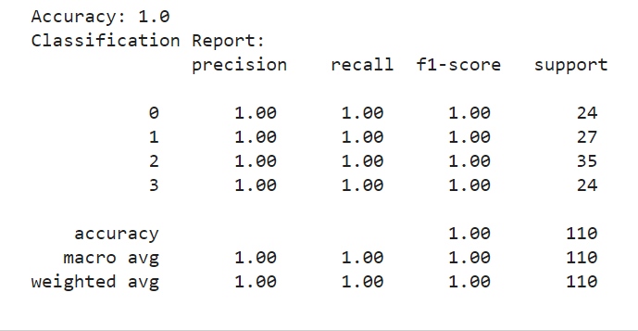
PERFORMANCE METRICS –RANDOM FORREST

Slide 14
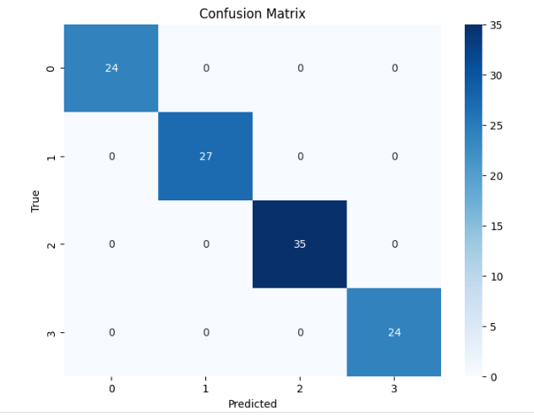
CONFUSION METRIX – DECISION TREE

Slide 15
PROGRESS TILL TODAY
Following is the progress of the project
The raw data has been collected as drive test logs from different clusters in GB area
CSV file has been generated from collected drive test logs containing important features
The features of CSV file are “log name”, “date”, “time”, “size of log in KB”, “label” and “Slice” are retained
Data cleaning and analysis have been completed that is null values and outliers detection, average, max, min and sum of size of logs in KB
Data Visualization (EDA) has been carried out.
Label encoding is performed on feature “label” in data frame loaded
Data Oversampling has been implemented to enhanced output performance of model
Data split into train and test data for training of models and performance evaluation of implemented model
Random Forrest Model has been implemented as collected data is supervised data
Performance metrics of Random Forest including accuracy, precision, recall and F1-score, have been evaluated
Confusion Matrix of Random Forest including accuracy, precision, recall and F1-score, have been evaluated
Other supervised machine learning models such as ANN, SVM, KNN, Decision Tree, logistic Regression will be implementation and output performance will be evaluated as performance and confusion metrics

Slide 16
THANKS

Slide 17
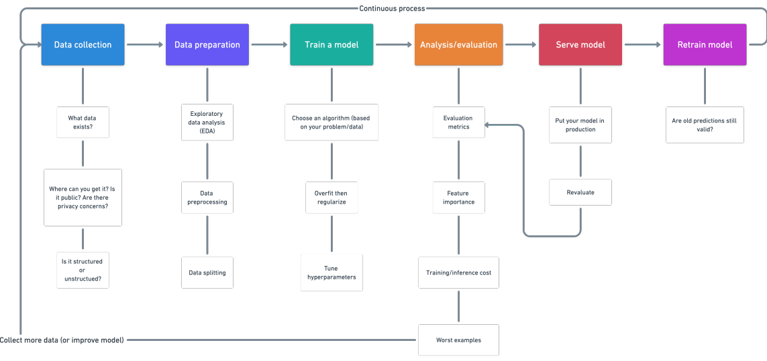
PROPOSED METHODOLOGY- FLOW CHART

